Slide 1

Decode Gaming Behavior
Mentorness Internship Project By Sushmita Enjmuri

Slide 2
Content
Project Overview
Problem Statement
Dataset Description
Analysis
Key Insights
Summary

Slide 3
Project Overview
"Decode Gaming Behavior" dataset consists of two tables "Player Details" and "Level Details". This dataset aim is to analyze gaming app data to understand player behavior and performance. Using SQL queries, we'll explore player engagement, skill progression, and areas for game improvement. Our goal is to provide actionable insights for game development decisions through concise data exploration, query formulation, and visualization techniques.

Slide 4
Problem Statement
Players play a game divided into 3-levels (L0,L1 and L2)
Each level has 3 difficulty levels (Low, Medium, High)
At each level, players have to kill the opponents using guns/physical fight.
Each level has multiple stages at each difficulty level.
A player can only play L1 using its system generated L1_code.
Only players who have played Level1 can possibly play Level2 , using its system generated L2_code.
By default a player can play L0.
Each player can login to the game using a Dev_ID.
Players can earn extra lives at each stage in a level.

Slide 5
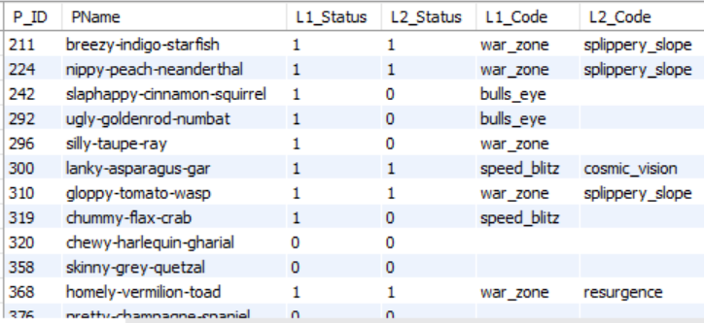
Dataset Description
Player Details Table:
• `P_ID`: Player ID
• `PName`: Player Name
• `L1_status`: Level 1 Status
• `L2_status`: Level 2 Status
• `L1_code`: Systemgenerated Level 1 Code
• `L2_code`: Systemgenerated Level 2 Code

Slide 6
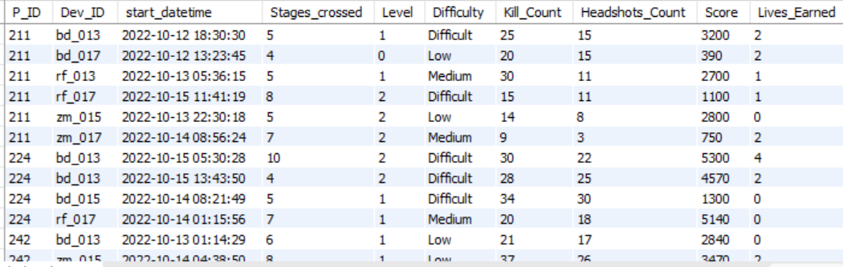
Level Details Table:
• `P_ID`: Player ID
• `Dev_ID`: Device ID
• `start_time`: Start Time
• `stages_crossed`: Stages Crossed
• `level`: Game Level
• `difficulty`: Difficulty Level
• `kill_count`: Kill Count
• `headshots_count`: Headshots Count
• `score`: Player Score
• `lives_earned`: Extra Lives Earned

Slide 7
Analysis

Slide 8
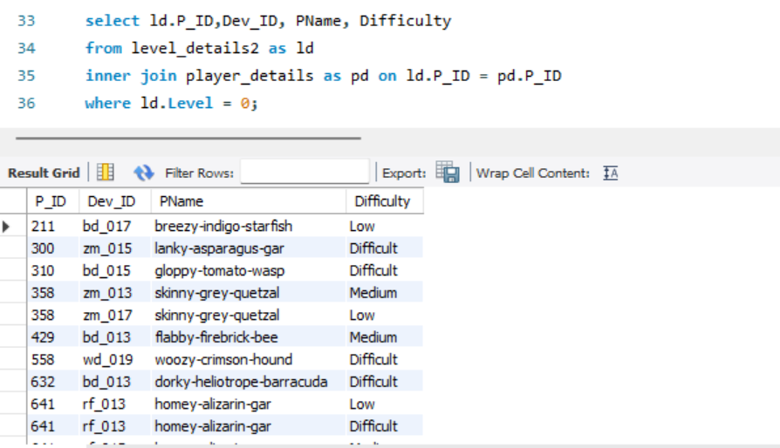
Q1) Extract P_ID, Dev_ID, PName and Difficulty_level of all players at level 0.

Slide 9
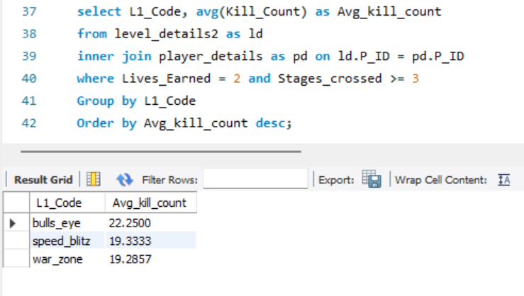
Q2) Find `Level1_code`wise average `Kill_Count` where `lives_earned` is 2, and at least 3 stages are crossed.

Slide 10
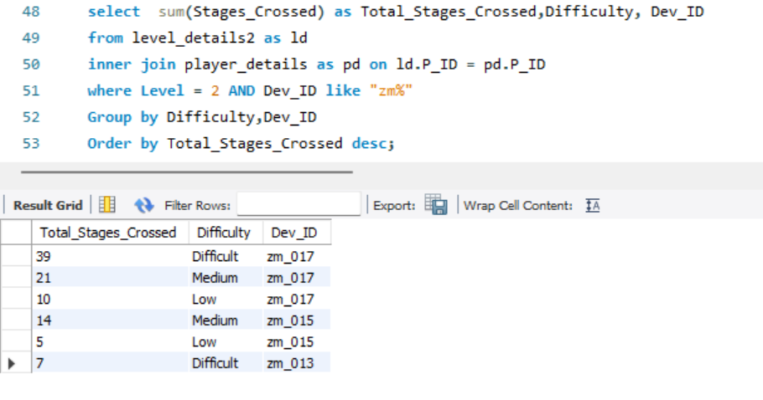
Q3) Find the total number of stages crossed at each difficulty level for Level 2 with players using `zm_series` devices. Arrange the result in decreasing order of the total number of stages crossed.

Slide 11
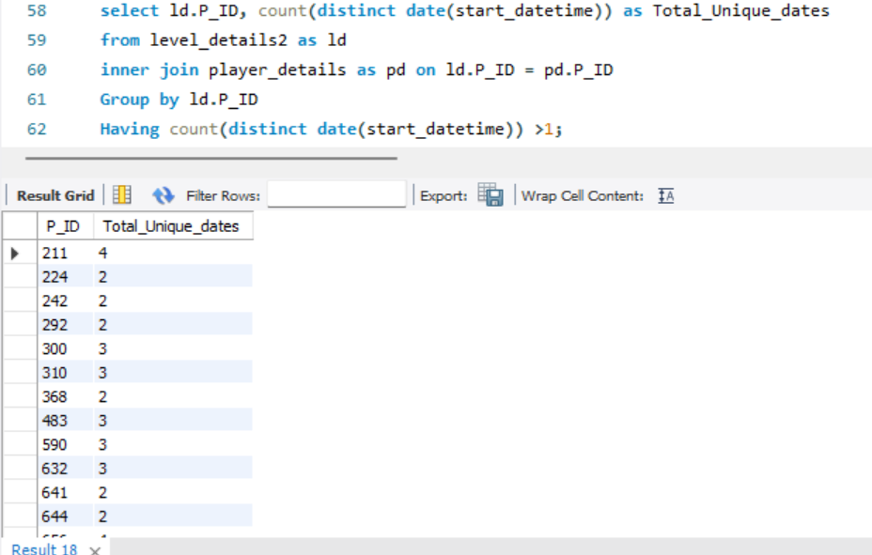
Q4) Extract `P_ID` and the total number of unique dates for those players who have played games on multiple days.

Slide 12
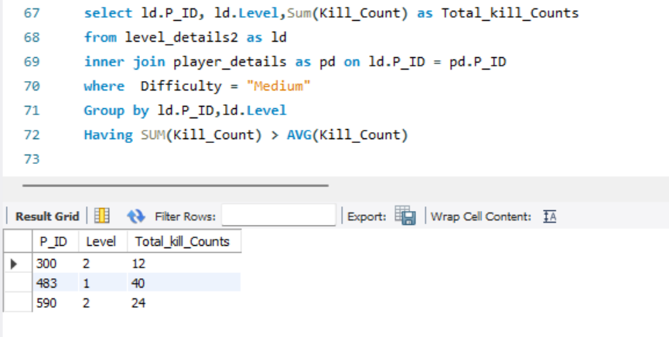
Q5) Find `P_ID` and levelwise sum of `kill_counts` where `kill_count` is greater than the average kill count for Medium difficulty.

Slide 13
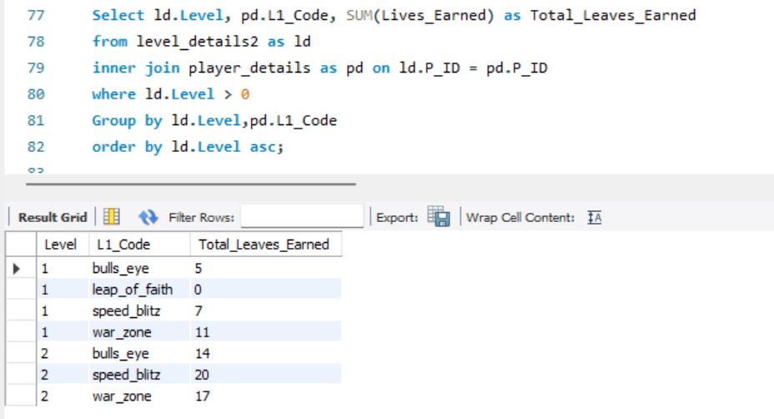
Q6) Find `Level` and its corresponding `Level_code`wise sum of lives earned, excluding Level 0. Arrange in ascending order of level.

Slide 14
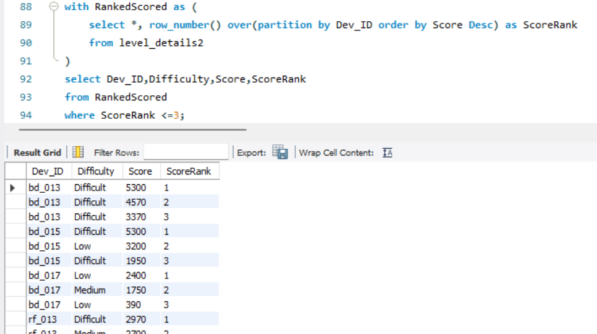
Q7) Find the top 3 scores based on each `Dev_ID` and rank them in increasing order using `Row_Number`. Display the difficulty as well.

Slide 15
Q7) Find the top 3 scores based on each `Dev_ID` and rank them in increasing order using `Row_Number`. Display the difficulty as well.

Slide 16
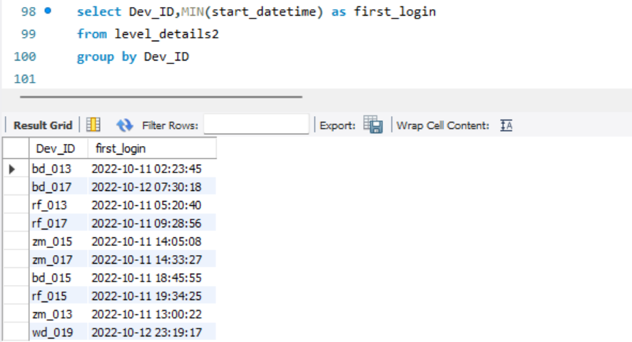
Q8) Find the `first_login` datetime for each device ID.

Slide 17
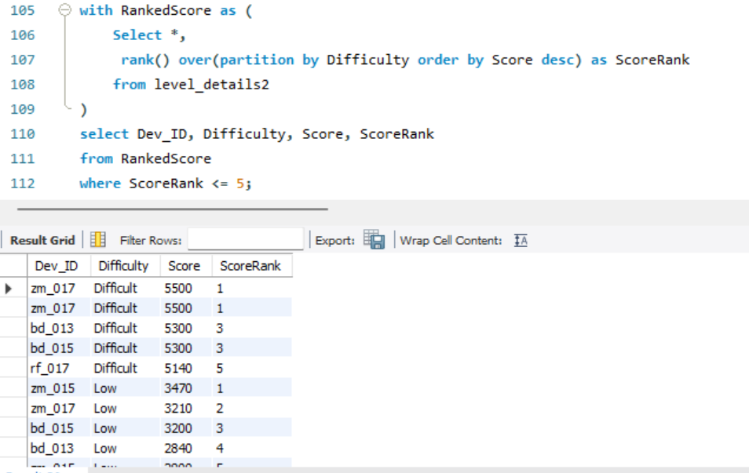
Q9) Find the top 5 scores based on each difficulty level and rank them in increasing order using `Rank`. Display `Dev_ID` as well.

Slide 18
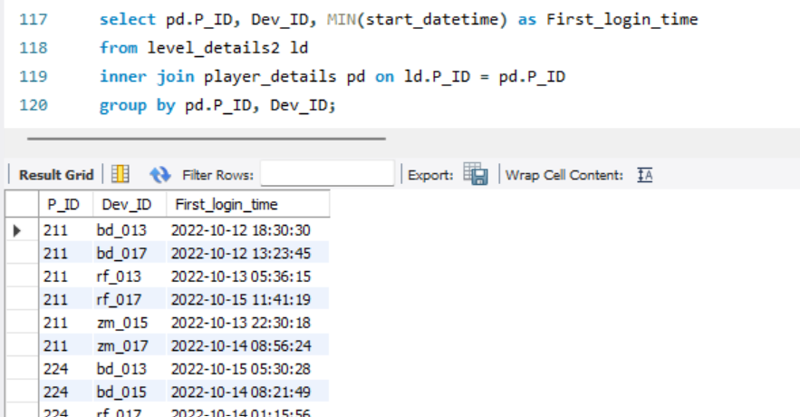
Q10) Find the device ID that is first logged in (based on `start_datetime`) for each player (`P_ID`). Output should contain player ID, device ID, and first login datetime.

Slide 19
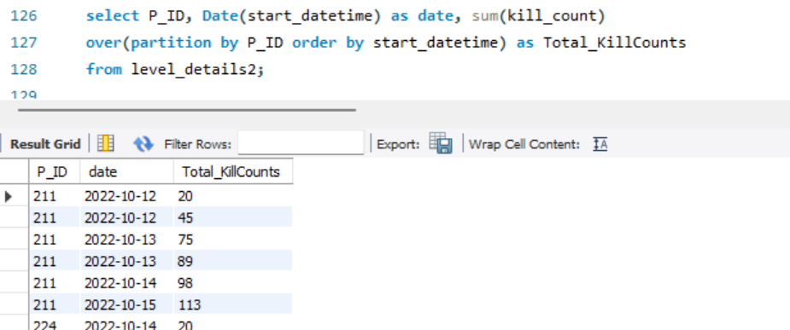
Q11) For each player and date, determine how many `kill_counts` were played by the player so far. a) Using window functions b) Without window functions
a) Using window functions

Slide 20
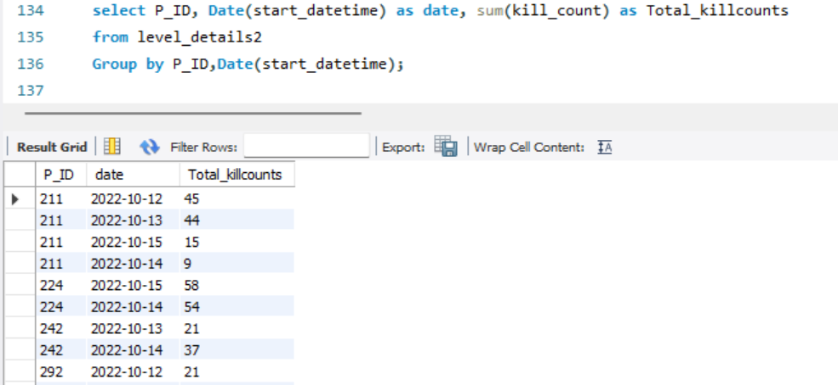
Q11) For each player and date, determine how many `kill_counts` were played by the player so far. a) Using window functions b) Without window functions
b) Without window functions

Slide 21
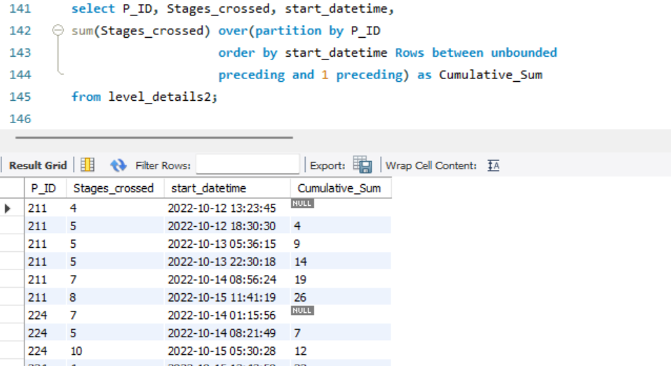
Q12) Find the cumulative sum of stages crossed over `start_datetime` for each `P_ID`, excluding the most recent `start_datetime`.

Slide 22
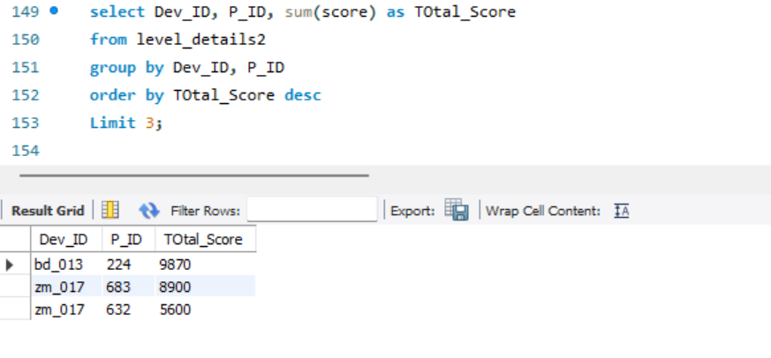
Q13) Extract the top 3 highest sums of scores for each `Dev_ID` and the corresponding `P_ID`.

Slide 23
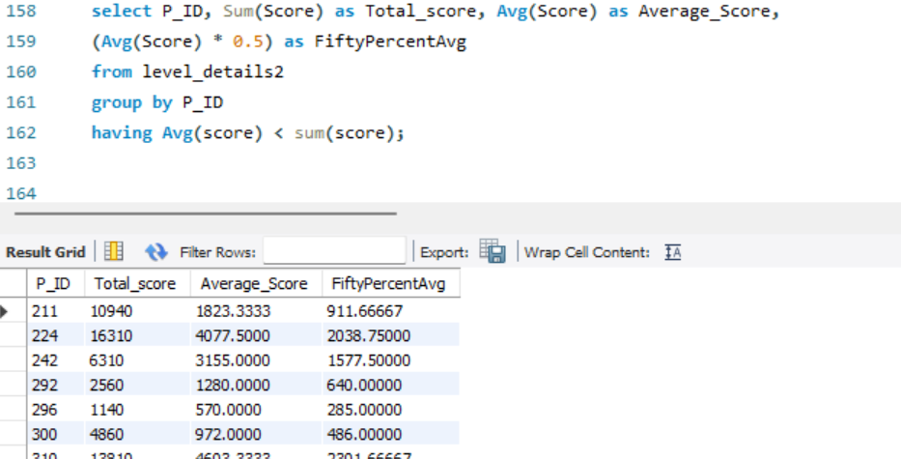
Q14) Find players who scored more than 50% of the average score, scored by the sum of scores for each `P_ID`.

Slide 24
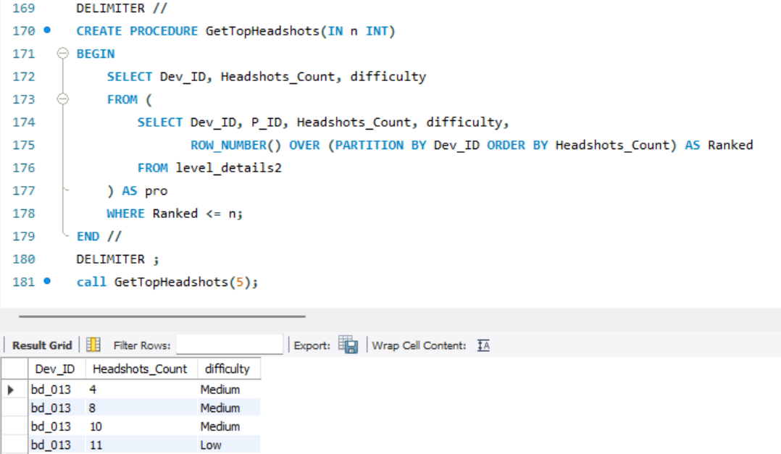
Q15) Create a stored procedure to find the top `n` `headshots_count` based on each `Dev_ID` and rank them in increasing order using `Row_Number`. Display the difficulty as well.

Slide 25
Key Insights
Average of Kill Count by L1_Code:
Bulls_eye : 22.2500
Speed_blitz : 19.3333
War_zone : 19.2857
The Device_ID “zm_017” series has got maximum stages crossed at Difficulty i.e.6
There are 14 players who played games on multiple days.
Sum of Leaves Earned:
Level 1 = 23
Level 2 = 51
Players who got highest scores:
ID: 224, Total_Score: 9870
ID: 683, Total_Score: 8900
ID: 632, Total_Score: 5600

Slide 26
Summary
Database Structure: A well-organized relational database schema was developed, containing tables like Player_Details, Level_Details storing player information, game levels.
Data Analysis: Performed various SQL queries were crafted to analyze data, including calculating total scores, identifying top scores, and finding players with specific metrics.
Window Functions: Performed Advanced analytical tasks, such as ranking scores and calculating cumulative sums, were accomplished using window functions like Rank(), ROW_NUMBER() and SUM() OVER() .
Stored Procedures and Functions: Complex SQL logic was encapsulated using PL/pgSQL stored procedures and functions to enhance code modularity and database performance. Functions like ‘GetTopHeadshots’ were designed to compute aggregated values.
Overall, the project showcases expertise in database design, SQL programming, and data analysis, providing valuable insights into player behavior and game performance.

Slide 27
Thank You

